Slide 1
Apartheid Images

Slide 2
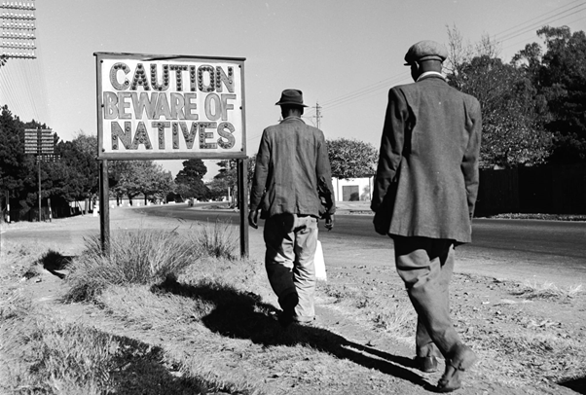
https://www.history.com/topics/africa/apartheid#&gid=ci0245618b100025ab&pid=photo-gallery-apartheid-getty-2664162

Slide 3
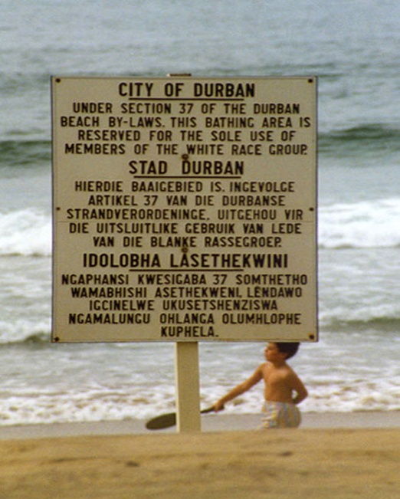
https://www.britannica.com/topic/apartheid

Slide 4
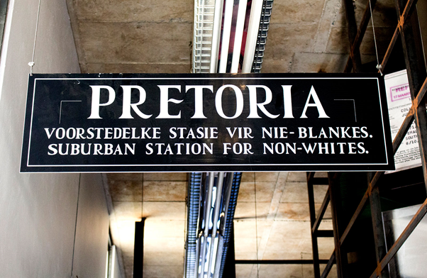
https://www.britannica.com/topic/apartheid

Slide 5
https://www.outadventures.com/gay-travel-blog/apartheid-in-south-africa/

Slide 6
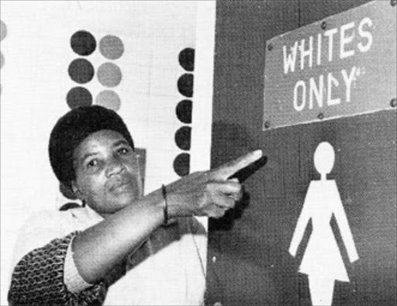
https://www.sowetanlive.co.za/news/south-africa/2013-12-10-recalling-life-under-apartheid-in-sa/

