Slide 1
Structure of the Plot

Slide 2
THE PLOT
This is the sequencing of events to create a story. There are 5 essential parts of the plot:

Slide 3
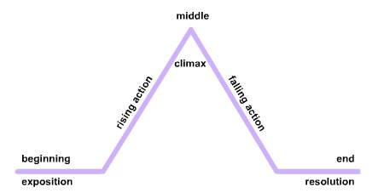
http://ontrack-media.net/english_gateway/E6/g_E6RdM2L3/g_E6RdM2L3s2a.html

Slide 4
EXPOSITION
This is the beginning of the story. It introduces: Characters
Setting
Some aspects of the story Some aspects of the conflict

Slide 5
EXPOSITION IN THINGS FALL APART
Okonkwo is presented at the height of his glory in the Ibo community of Umuofia.
He has established himself through hard work and determination. This makes his fall more tragic.
His greatest fear is that he will be a failure like his father, Unoka: weak, effeminate and poor.

Slide 6
RISING ACTION
This relates to events that are unresolved and that lead to the climax.
These events, by revealing character flaws and background circumstances, create suspense and tension.

Slide 7
RISING ACTION IN THINGS FALL APART
Okonkwo is exiled after accidentally killing Ezeudu’s son. On his return, he sees the effects of Christianity on his tribe.
Umuofian leaders burn the church after Enoch unmasks the egwugwu.
Umuofian leaders, including Okonkwo are arrested by the District Commissioner.

Slide 8
THE CLIMAX
This is the turning point of the story.
It is the highest level of suspense or action.

Slide 9
CLIMAX IN THINGS FALL APART
Okonkwo kills the head messenger.

Slide 10
FALLING ACTION
These are events that occur after the climax.
These events lead to the resolution.

Slide 11
FALLING ACTION IN THINGS FALL APART
The villagers allow the white government's messengers to escape.
Okonkwo realizes that none of the villagers support him.
The Ibo people will not go to war against the colonial government.

Slide 12
RESOLUTION
This is the end of the story where the conflicts and problems are resolved.

Slide 13
RESOLUTION IN THINGS FALL APART
Okonkwo chooses to commit suicide rather than be tried in a colonial court.
His death is considered a sin and he is denied the burial of an elder of the clan.

