Slide 1
Igbo Culture Images

Slide 2
The CONTINENT AFRICA
Location of the Igbo homeland (dark green)
in Nigeria (green)

Slide 3
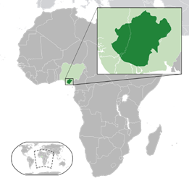
https://en.wikipedia.org/wiki/Igbo_people

Slide 4
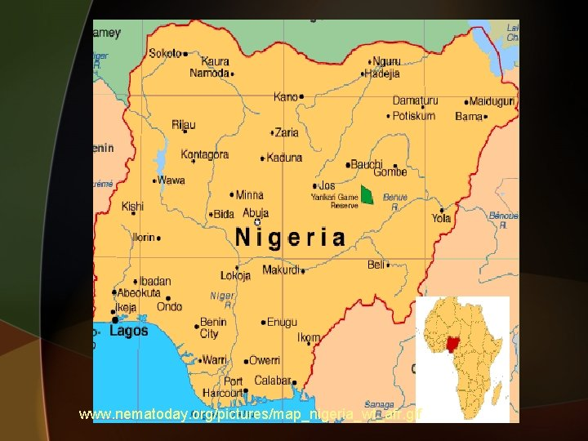
https://slidetodoc.com/things-fall-apart-introduction-and-background-to-african/

Slide 5
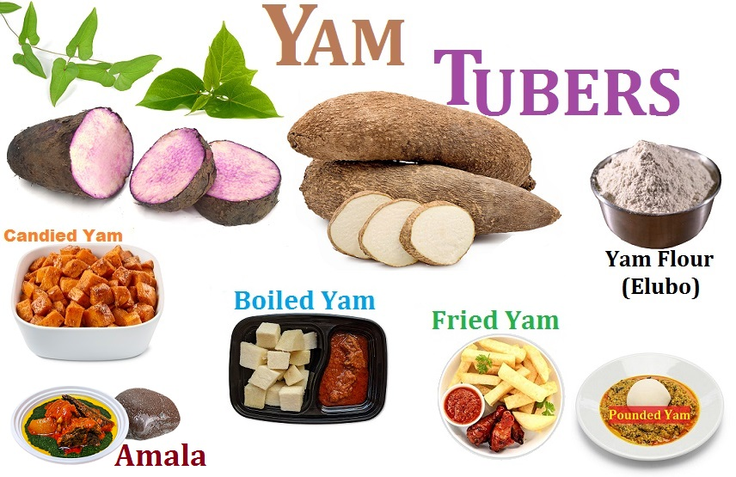
https://www.google.com/search?q=ancient+igbo+tribe+food+yams+and+kola+nuts&tbm=isch&ved=2ah

Slide 6
KOLA NUTS

Slide 7
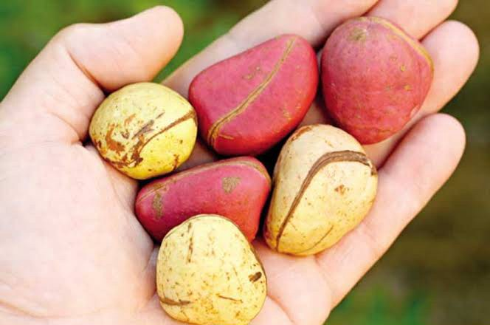
https://www.google.com/search?q=ancient+igbo+tribe+food+yams+and+kola+nuts&tbm=isch&ved=2ah

Slide 8
https://slidetodoc.com/things-fall-apart-introduction-and-background-to-african/

Slide 9
https://slidetodoc.com/things-fall-apart-introduction-and-background-to-african/

