Slide 1
Zoot

Slide 2
ZOOT SUITS

Slide 3
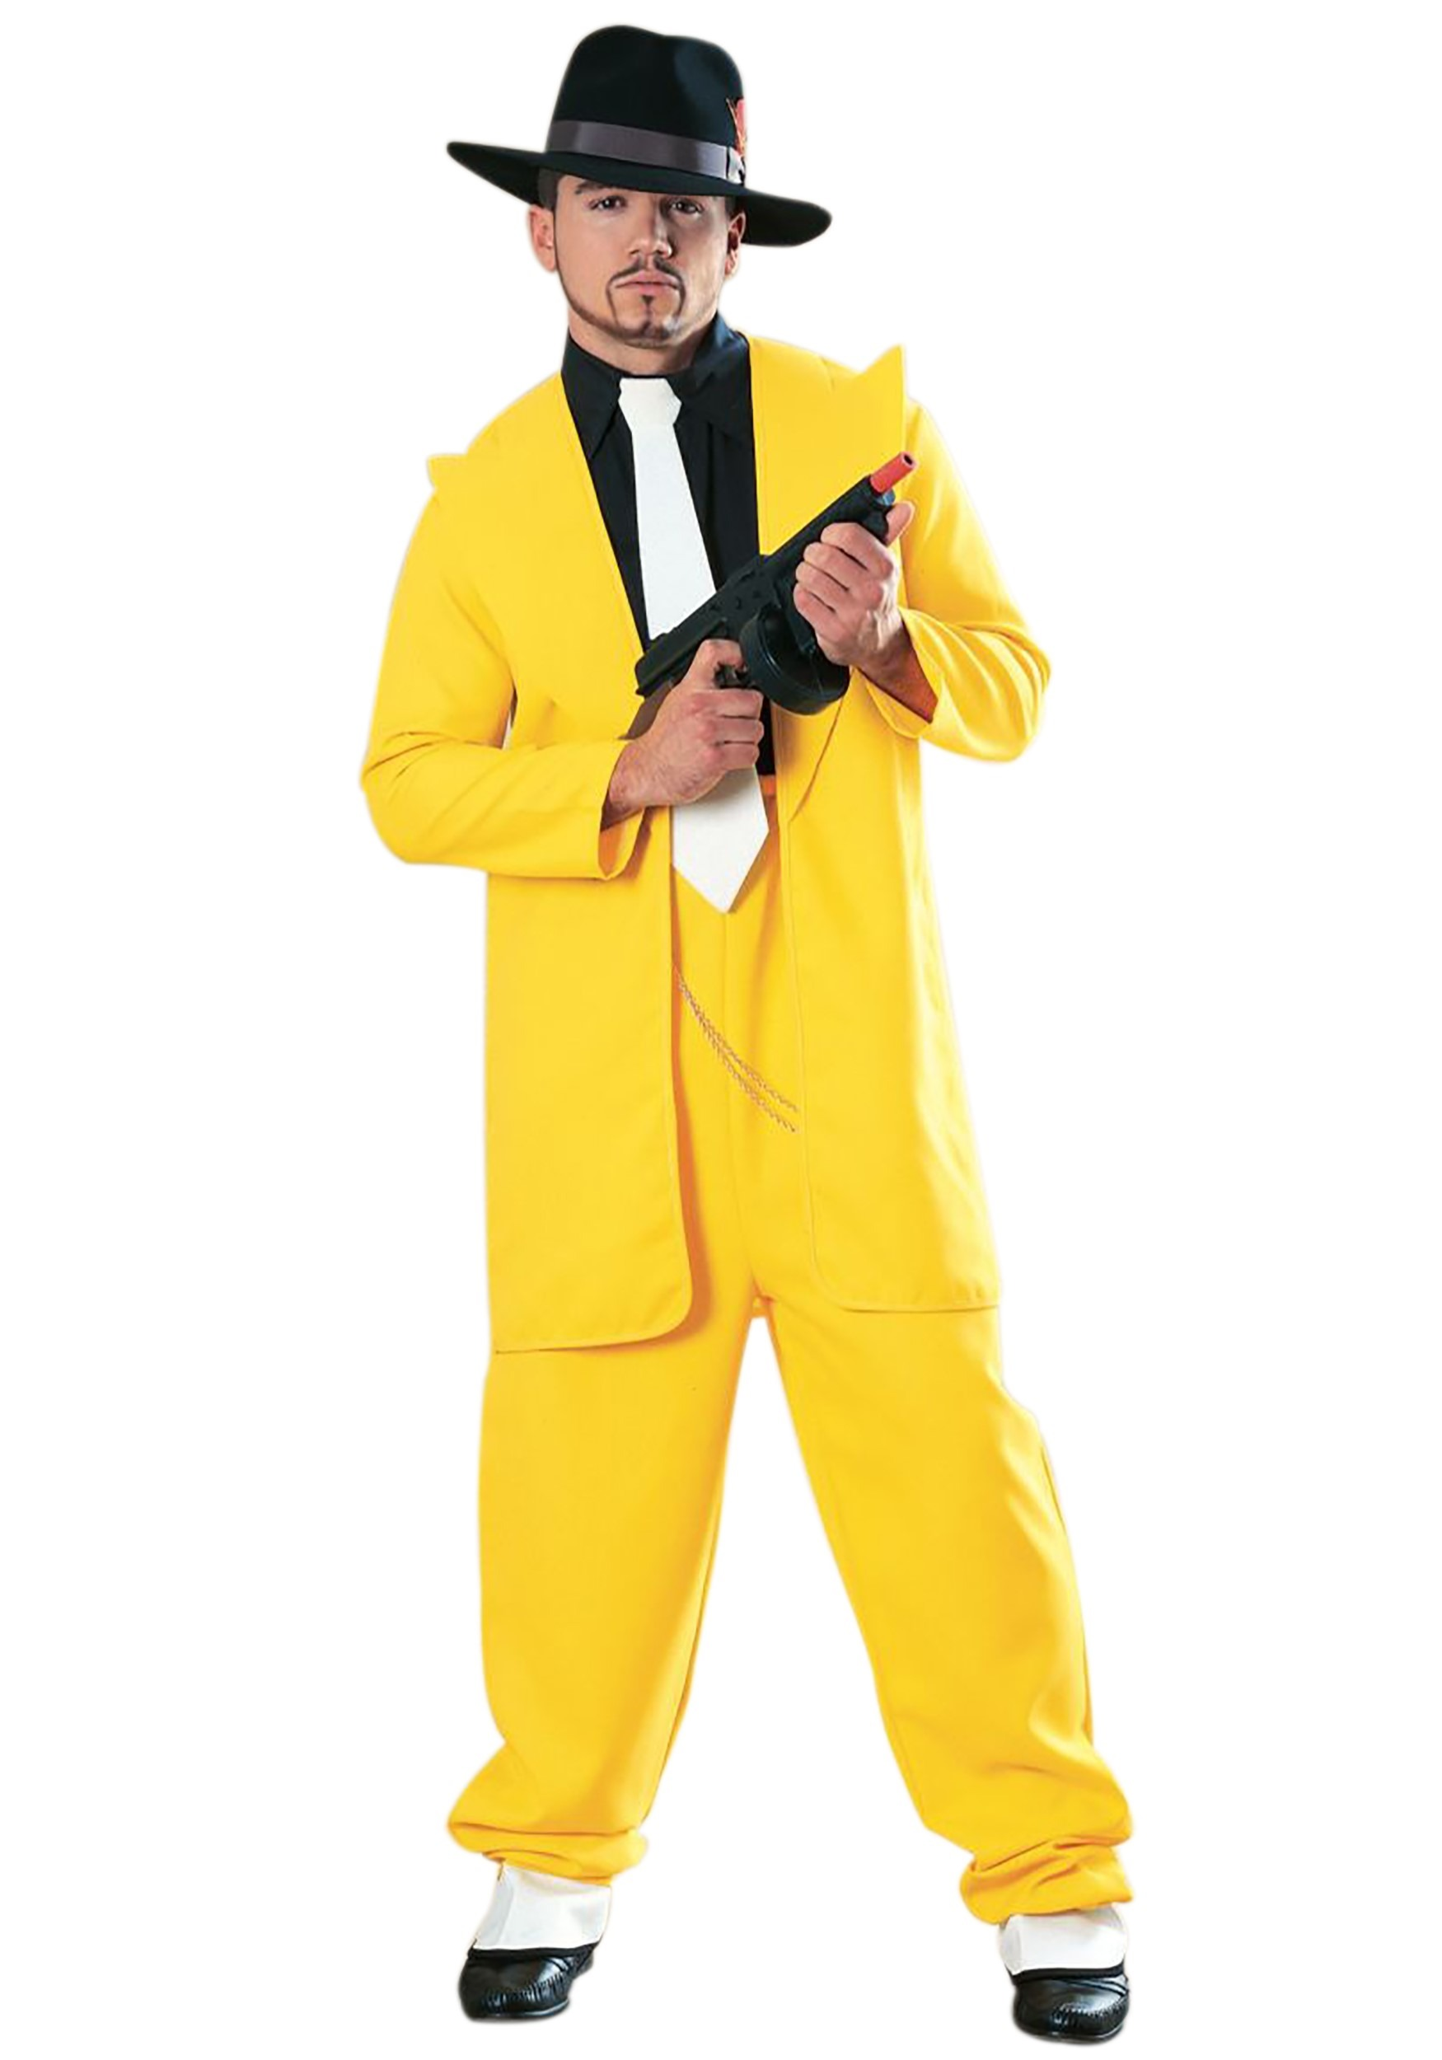
Https: //www.ebay.co.uk/itm/Yellow-Zoot-Suit-Mens-Gangster -Fancy-Dress-M

Slide 4
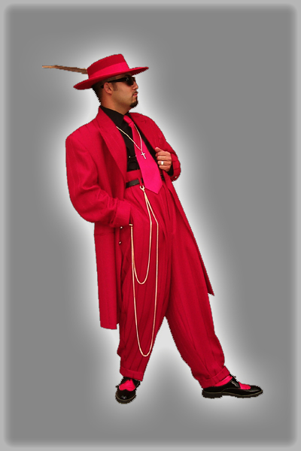
https://www.contemposuits.com/zoot-suits--how-they-differ-from-a-business-suit.html

Slide 5
JARMAN SHOES

Slide 6
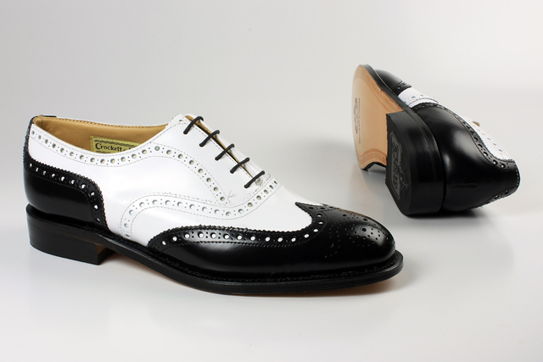
http://www.dickwhittington.co.za/jit_default_1115.html

