Slide 1
Syllables and Couplets
Gr 10

Slide 2
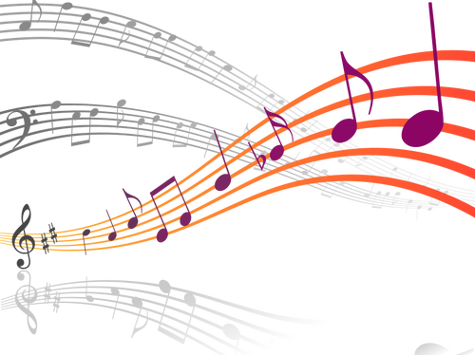
A syllable is the unit of sound that makes up words.
End rhyme: the last word of a line sounds the same as the last word of another line.
A rhyming couplet: two successive lines of rhyming poetry, with the same meter.
To determine the number of syllables in a word, clap out the word. Each clap is a syllable.

Slide 3
WHAT IS METER?
A meter, or a foot, is a unit of rhythm.
Each foot has a certain number of syllables, and a specific pattern of emphasis. These are repeated to form a line of verse.
Double/ double /toil and /trouble/
Shall I/ compare/ thee to/ a sum/mer’s day/
4 feet (tetrameter)
5 feet (pentameter)
2 syllables
2 syllables
Emphasis: trochee (DUH-duh)
Emphasis: iambic (duh-DUH)

Slide 4
The Man of Double Deed
by Anonymous
There was a man of double deed,
Who sowed his garden full of seed;
When the seed began to grow,
'Twas like a garden full of snow;
When the snow began to melt,
'Twas like a ship without a belt;
When the ship began to sail,
'Twas like a bird without a tail;
When the bird began to fly,
'Twas like an eagle in the sky;
When the sky began to roar,
'Twas like a lion at my door;
When my door began to crack,
'Twas like a stick across my back;
When my back began to smart,
'Twas like a penknife in my heart;
And when my heart began to bleed,
'Twas death, and death, and death indeed.
https://www.poetryfoundation.org/poems/56374/the-man-of-double-deed

Slide 5
Write a poem of not less than 8 lines, using rhyming couplets.

